Slide 1
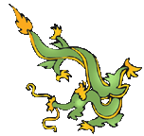
Ancient Chinese DRAGONS
Shared by Lin Donn
Illustrated by Phillip Martin

Slide 2

Ancient China
Today, we know that magical dragons exist only in imagination and myth. They are mythical creatures.
But in ancient China, the people firmly believed that dragons were real and powerful. The dragon was the sign of the emperors. Over time, “The Dragon” became a nickname for China.
Notes:
Teacher Notes:

Slide 3
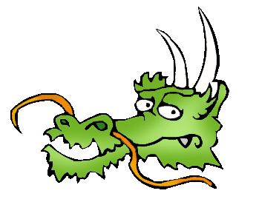
Ancient China
In ancient China, dragons were thought to be wise, caring, and a bit mischievous. They did not breathe fire. They had personalities. They had magical powers. They could disappear whenever they wanted.
They could turn into beasts if
they were angry.

Slide 4
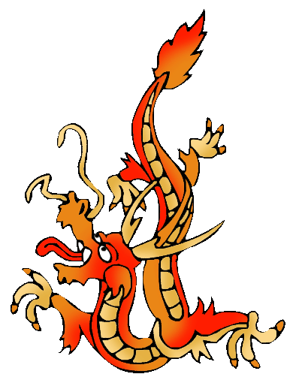
Ancient China
Dragons in ancient China were a composite (a mix) of parts from different animals. These mythical creatures had a camel head, a snake neck, fish scales, eagle claws, tiger paws, ox ears, deer horns, and whiskers. Their job in ancient China was to act as guardians.

Slide 5
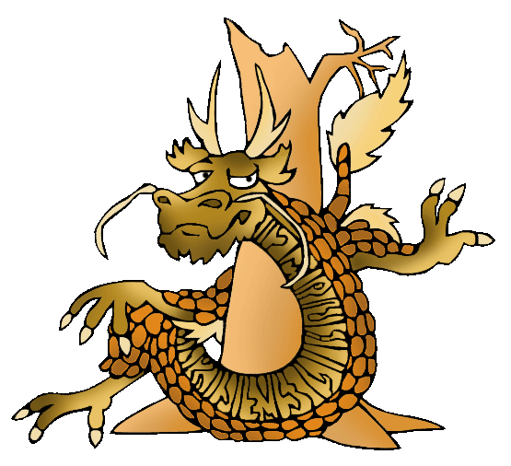
Wood Dragons
Legend says …. Wood dragons are brown.
They guard the forest. They are imaginative and curious, and come up with brilliant new ideas. They will even
compromise. They are not as selfish as the other dragons. They share
well.

Slide 6
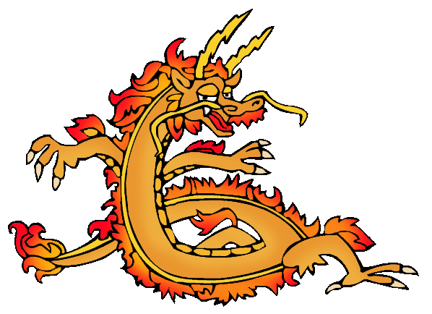
Fire Dragons
Legend says …. Fire dragons are red.
They guard the wind, fire, lightning and sky. These dragons are the most
outgoing and short-tempered. They have the ability to gain massive popular support.

Slide 7
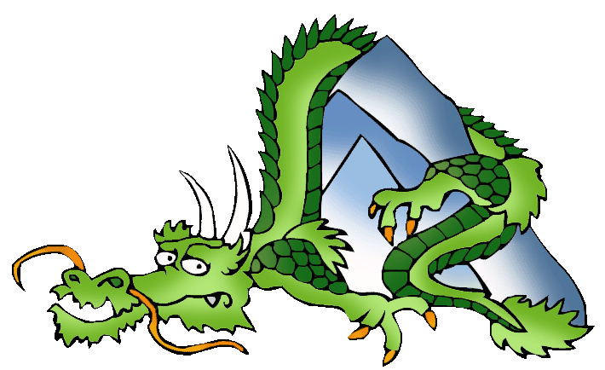
Earth Dragons
Legend says … Earth dragons are green.
They guard the earth, the crops, and the mountains.
They know the value
of cooperation.

Slide 8
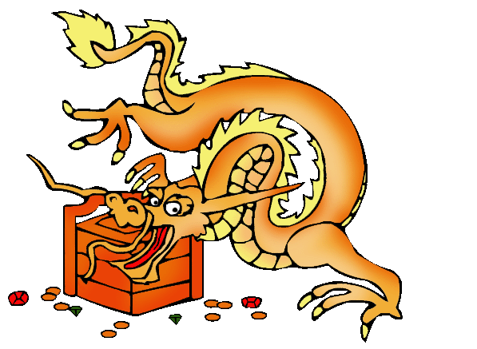
Metal Dragons
Legend says …. Metal dragons are gold.
They guard metals and precious gems. These dragons succeed because they refuse to accept failure. They have little caring for the feeling of others. These dragons are quite selfish.

Slide 9
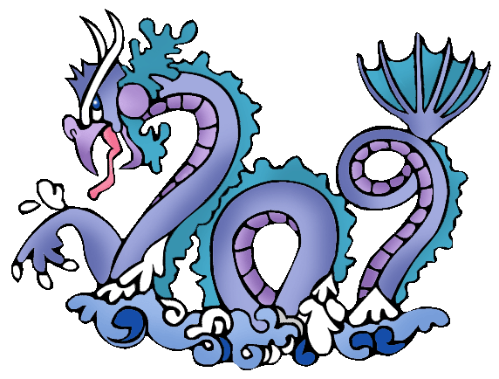
Water Dragons
Legend says …. Water dragons are blue.
They guard rivers, rain, wells, and water. They get along well with people. They
know how to accept defeat and how to rebuild.

Slide 10
Conclusion
Since the ancient Chinese firmly believed that dragons were real and had special magical powers, dragons were an important part of ancient Chinese daily life. They were blamed for a great deal that went wrong, and credited with things that went right.
Dragons were (and still are) a very
fun ancient Chinese invention!
Notes:
Teacher Notes:

Slide 11
Discussion
Question: Do magical dragons really exist? Did they ever exist?
Answer: Nope. Dragons are mythical creatures. They exist only in myth and imagination.
Question: Why do you think people might have invented these mythical creatures?
Answer: No one knows. We can only guess.
Notes:
Teacher Notes:
Magical dragons, of course, never existed. But the ancient Chinese believed they were very real and could effect their daily life. But they were not gods. They were magical beings, similar to the unicorn in ancient Greek mythology, but far more complicated and mischievous. The ancient Chinese used dragons to denote status. The fewer the toes on a dragon design on a robe, the lower the rank of the official. They called on dragons for protection. And they thought of dragons as personalities.

Slide 12
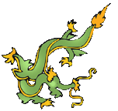
Free Clip Art &
Templates
Created by a professional and published artist, Phillip Martin, go here to find:
Free Ancient China Clip Art
Free Templates and how to use them

Slide 13
Presentations
To learn more about ancient China, click here
We’re published! Click here to see some of the neat things we’ve written.

Slide 14

Explore …
PPPST.COM

